Slide 1
1. Analyze the following quote by John Adams.
2. Please complete a written response that describes your thoughts regarding the quote.
“A government of laws, and not of men.”

Slide 2
President John Adams PRESIDENT JOHN ADAMS
PRESENTED BY:
THE HHS U.S. HISTORY DEPARTMENT
COACH B.O. STREETMAN, INSTRUCTOR

Slide 3
ENGAGEMENT!!

Slide 4
ENGAGEMENT INSTRUCTIONS
1. Students will examine the standard and essential questions.
2. (Hook) Students will be asked to watch a video about President John Adams.

Slide 5
GEORGIA STANDARDS OF EXCELLENCE
SSUSH6: Analyze the challenges faced by the first five presidents and how they responded.

Slide 6
STATEMENT OF INQUIRY…(I CAN STATEMENT)
1. I can explain the challenges faced by the John Adams Administration and how he responded to these respective obstacles.

Slide 7
SUCCESS CRITERIA
We will know that we are successful when we can explain how President John Adams responded to various challenges that occurred during his administration.

Slide 8
KEY VOCABULARY TERMS
What words and people do I need to know?
Jay’s Treaty
President John Adams
Alien and Sedition Acts
The Election of 1800

Slide 9
PRESIDENT JOHN ADAMS VIDEO

Slide 10
EXPLORE, EXPLAIN, & ELABORATE !!

Slide 11
Explore, Explain, and Elaboration Strategy
1. Students and instructor will review GPS and LEQ.
2. Students will watch a video on John Adams.
3. Students will take notes, complete a reading passage, watch videos and create a graphic organizer that summarizes the “XYZ” Affair that occurred under the administration of President John Adams.

Slide 12
GEORGIA STANDARDS OF EXCELLENCE
SSUSH6: Analyze the challenges faced by the first five presidents and how they responded.

Slide 13
STATEMENT OF INQUIRY…(I CAN STATEMENT)
1. I can explain the challenges faced by the John Adams Administration and how he responded to these respective obstacles.

Slide 14
SUCCESS CRITERIA
We will know that we are successful when we can explain how President John Adams responded to various challenges that occurred during his administration.

Slide 15
KEY VOCABULARY TERMS
What words and people do I need to know?
Jay’s Treaty
President John Adams
Alien and Sedition Acts
The Election of 1800

Slide 16
JOHN ADAMS:
Takes notes from the slides
Copy the text in red.

Slide 17
John Adams Becomes 2nd President
After Washington retired, his Vice-President, John Adams became the second president.
Thomas Jefferson came in second. He became Vice-President.

Slide 18
Alien and Sedition Acts
President Adams was criticized for the XYZ affair by Democratic-Republican newspapers.
He blamed the papers and new immigrants for his problems.
To silence his critics, the Alien and Sedition Acts were passed.
These acts targeted aliens —immigrants who were not yet citizens.

Slide 19
Alien and Sedition Acts
One act increased the waiting period for becoming a U.S. citizen from 5 to 14 years.
Other acts gave the president the power to arrest disloyal aliens or order them out of the country during wartime.
A fourth act outlawed sedition. Saying or writing anything false or harmful about the government became illegal. Newspaper editors were arrested.
Many people thought the Alien and Sedition Acts violated the First Amendment.

Slide 20
John Adams Foreign Policy Video

Slide 21
JOHN ADAMS XYZ AFFAIR VIDEO

Slide 22
John Adams Official White House Biography

Slide 23
ASSIGNMENT:
Design a “cause and effect” graphic organizer that explains the relationship between the following events associated with the presidency of John Adams:
Jay’s Treaty
The XYZ Affair
The Alien and Sedition Acts
The Election of 1800

Slide 24
EVALUATION!!

Slide 25
EVALUATION STRATEGY
1. Review of standard, element, essential question and key vocabulary terms.
2. Students will complete a circle map that describes the presidency of John Adams.

Slide 26
GEORGIA STANDARDS OF EXCELLENCE
SSUSH6: Analyze the challenges faced by the first five presidents and how they responded.

Slide 27
STATEMENT OF INQUIRY…(I CAN STATEMENT)
1. I can explain the challenges faced by the John Adams Administration and how he responded to these respective obstacles.

Slide 28
SUCCESS CRITERIA
We will know that we are successful when we can explain how President John Adams responded to various challenges that occurred during his administration.

Slide 29
KEY VOCABULARY TERMS
What words and people do I need to know?
Jay’s Treaty
President John Adams
Alien and Sedition Acts
The Election of 1800

Slide 30
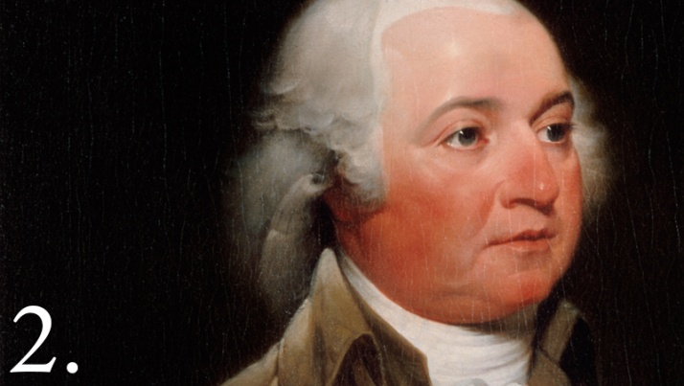
JOHN ADAMS CIRCLE MAP

